Slide 1
KIDNEY RENAL CLEAR CELL CARCINOMA:
EXPRESSION ANALYSIS
Andreu Bofill Pumarola
Sergio Castillo Lara
Adrià Pérez Culubret

Slide 2
Kidney renal clear cell carcinoma
KIRC is one of the most common Kidney cancer (95%).
Resistant to Chemotherapy/Radiotherapy.
Nephrectomy, primary treatment.
Objectives:
Search for gene expression differences.
Look for the causes of the variability between normal/tumor
Provide the biological characterization of this tumour.

Slide 4
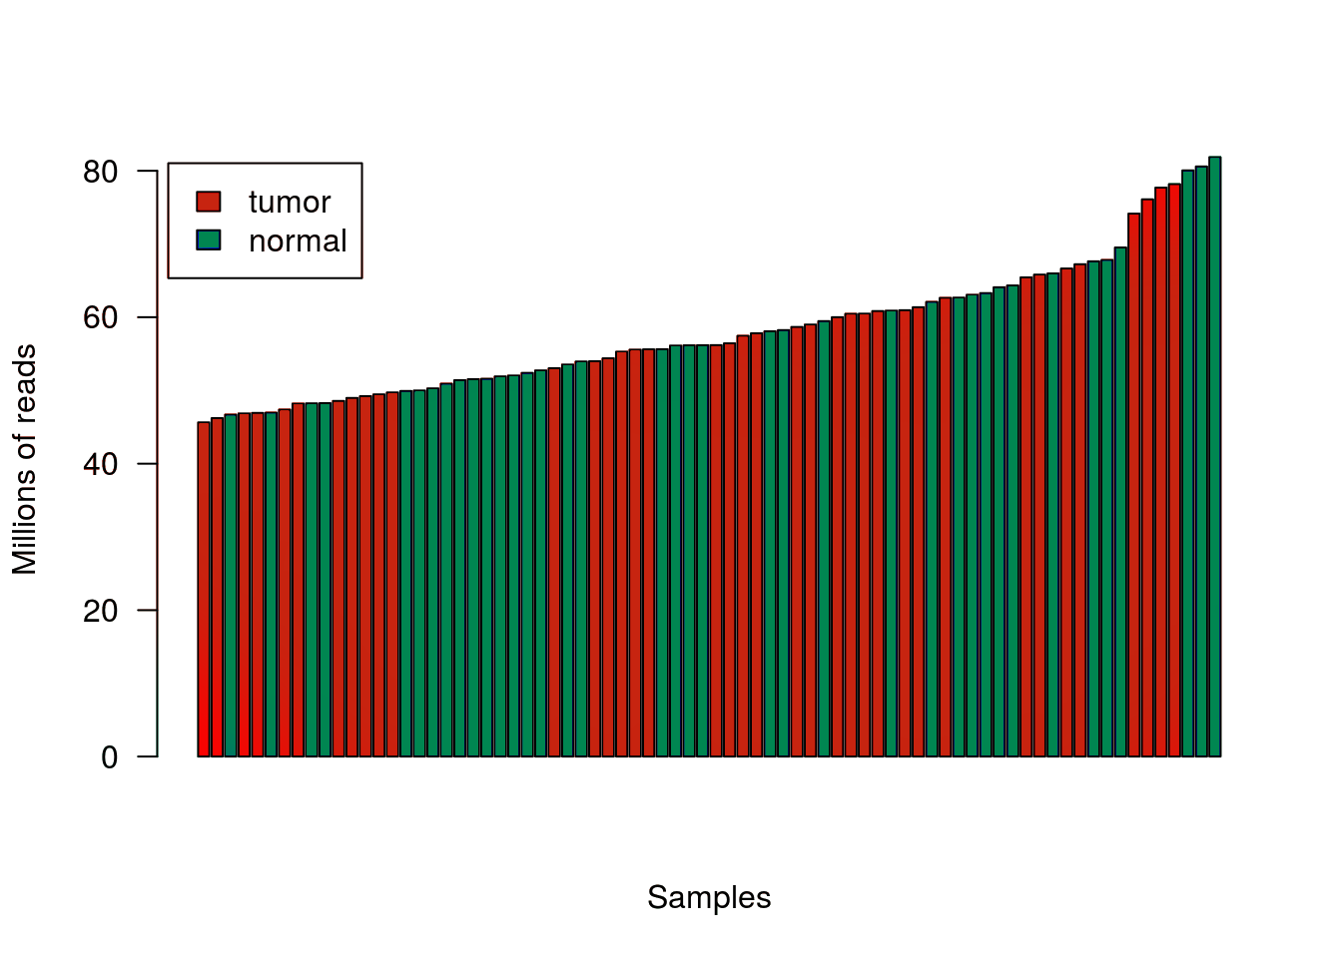
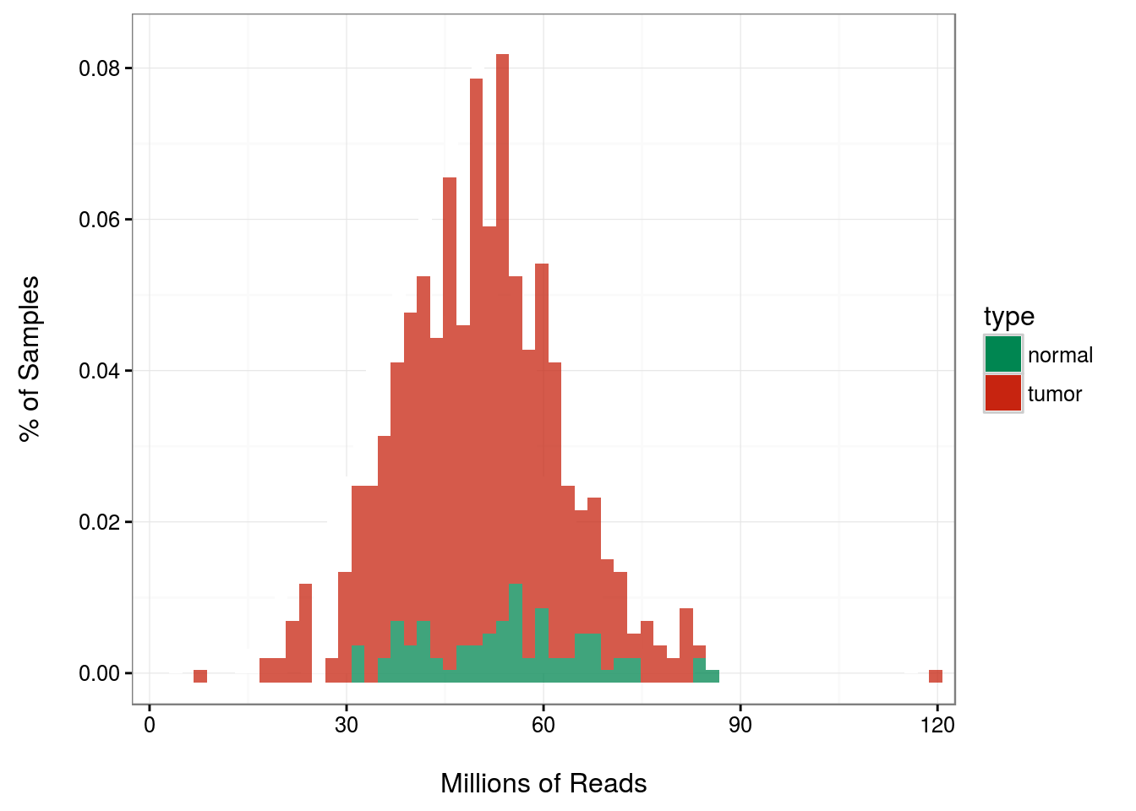
quality assessment
SAMPLE FILTERING
Library size filter
Tumour | Normal
298 | 48
Paired Data filter
Tumour | Normal
38 | 38
Initial dataset
Tumour | Normal
542 | 72

Slide 5
quality asseSsment
SAMPLE FILTERING
Initial dataset
Tumour | Normal
542 | 72
Library size filter
Tumour | Normal
298 | 48
Paired Data filter
Tumour | Normal
38 | 38
GENE FILTERING
Paired dataset
Nº genes
20,115
Paired dataset
Nº genes
12,495

Slide 6
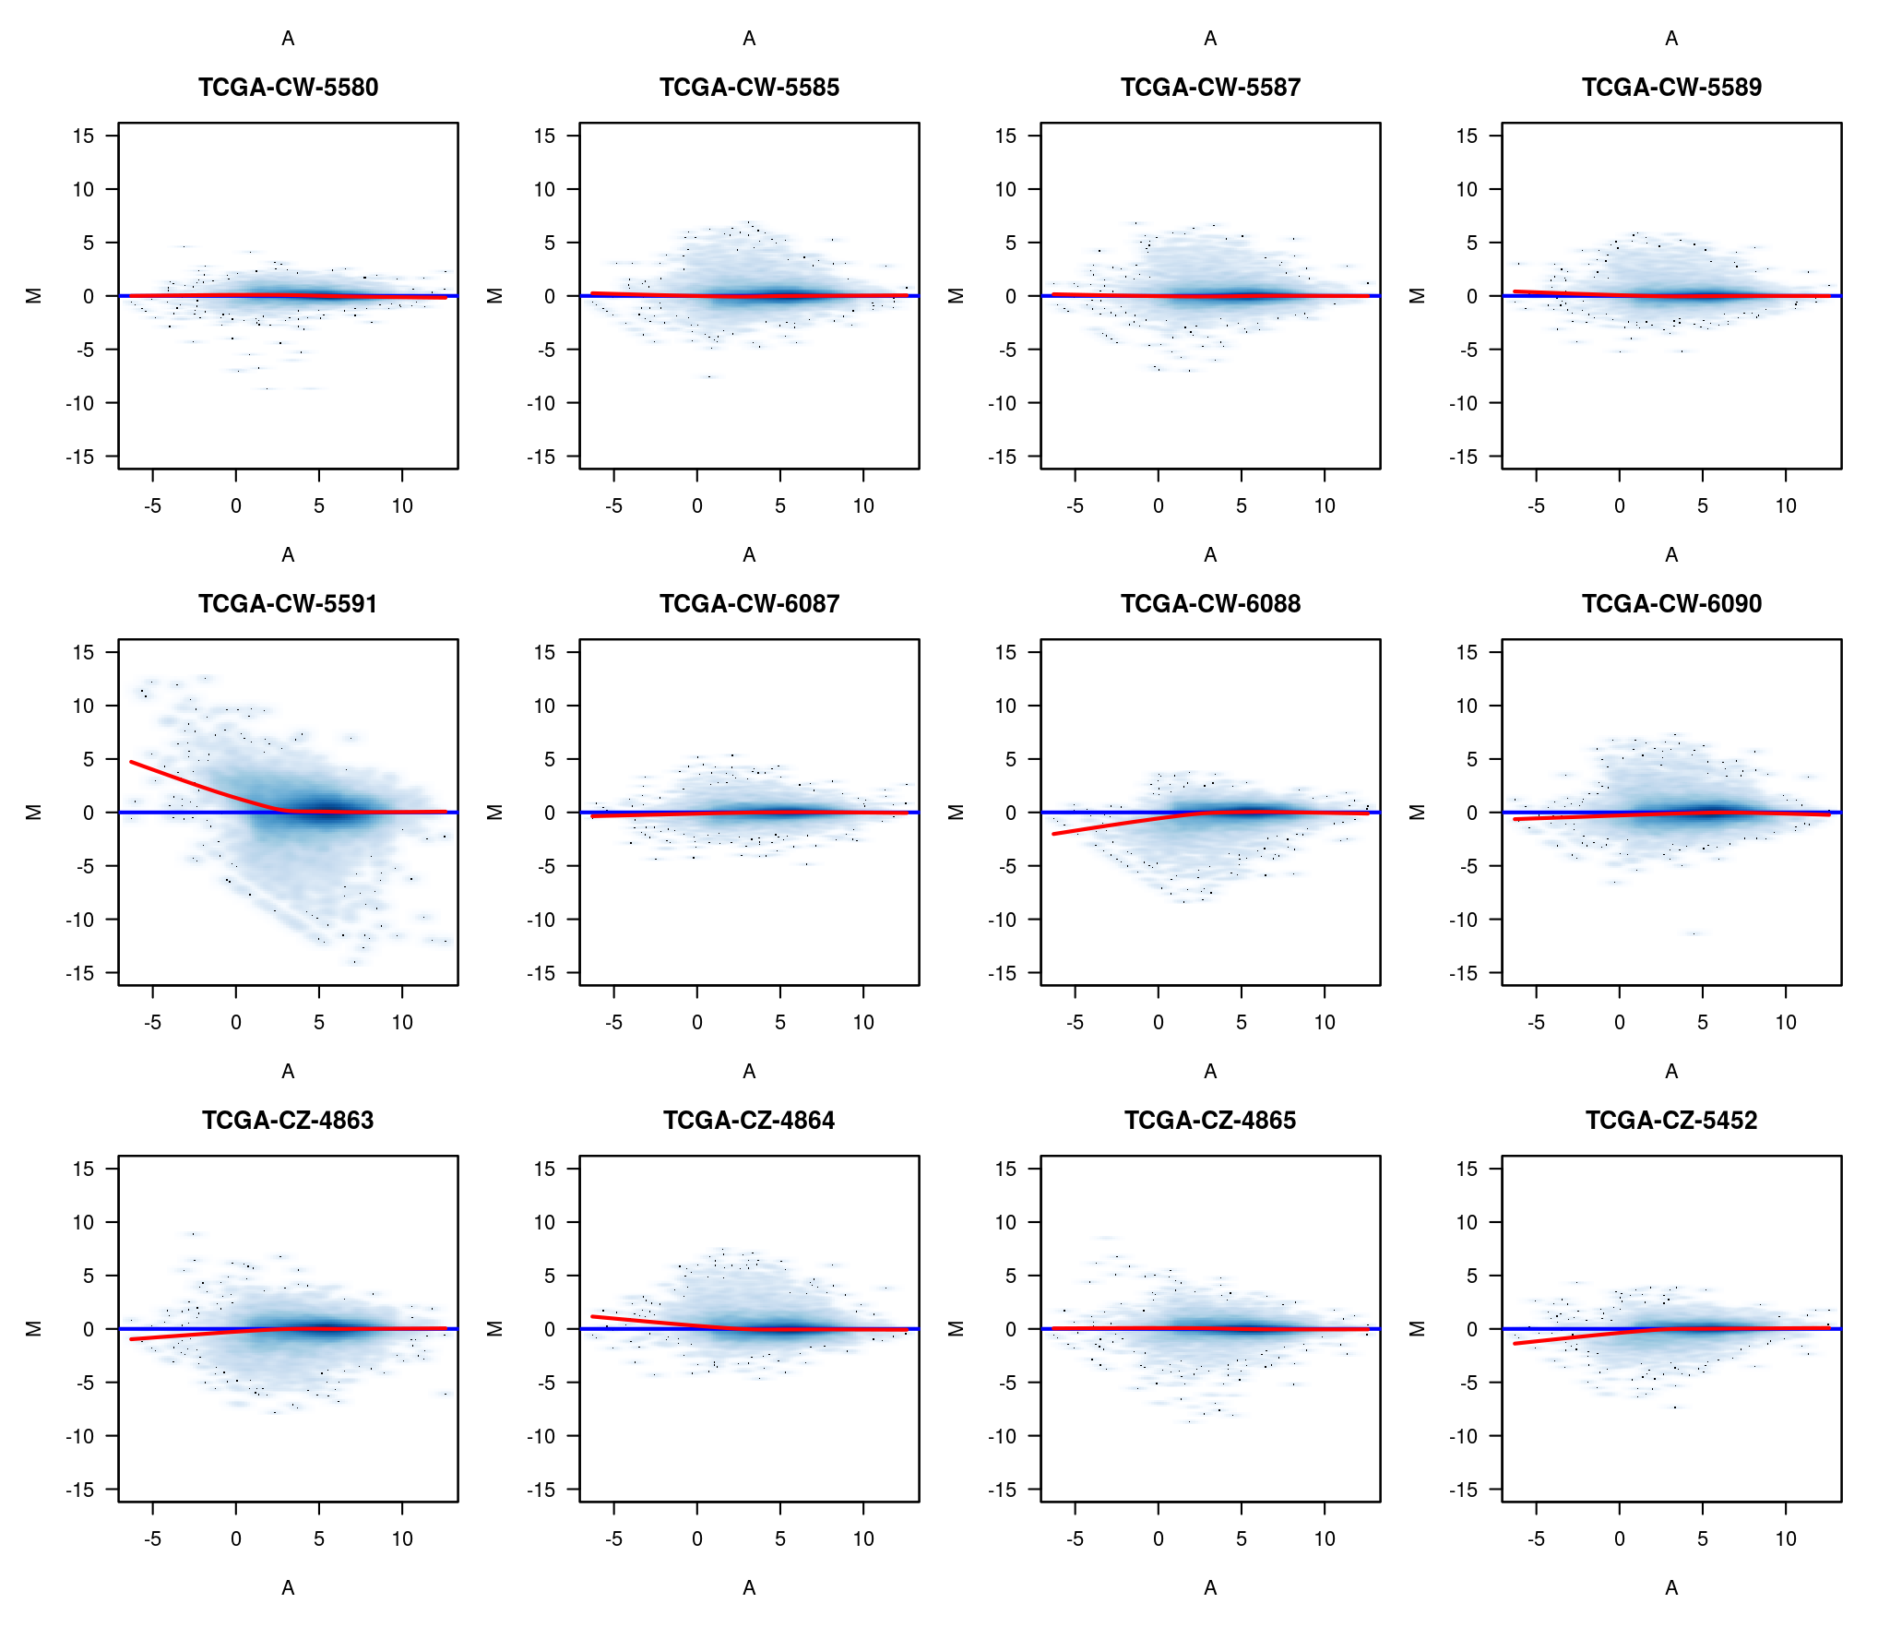
quality assesSment

Slide 7
batch effecT

Slide 8
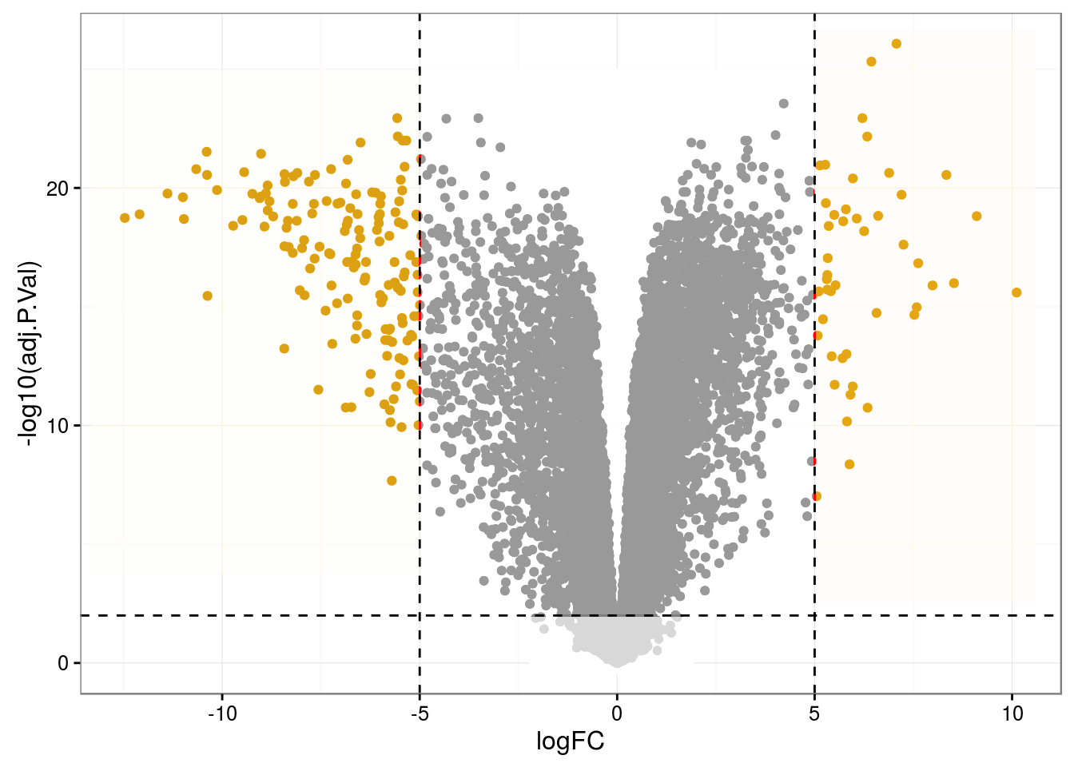
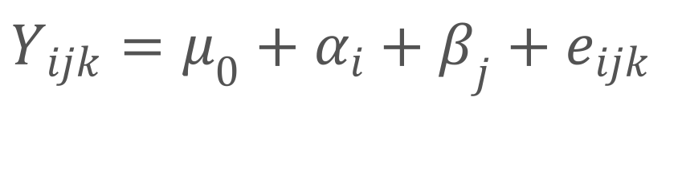
differential expression analysis
Paired dataset
Nº genes
12,495
$$Y_{ijk}=μ_{0}+α_{i}+β_{j}+e_{ijk}$$
DE genes
Over | Under
5,094 | 4,014
Strongly DE genes
Over | Under
46 | 153

Slide 9
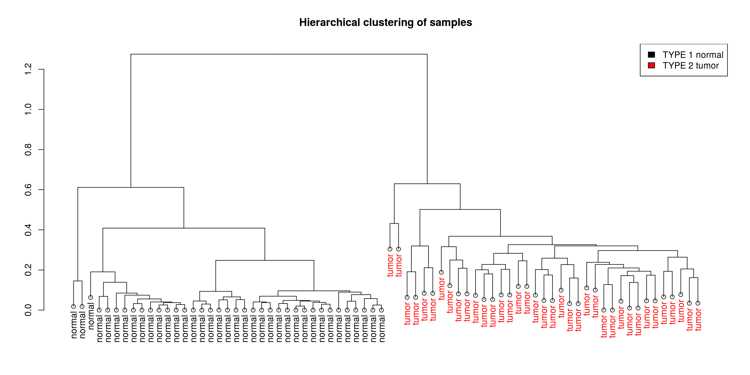
HIERARCHICAL CLUSTERING

Slide 10
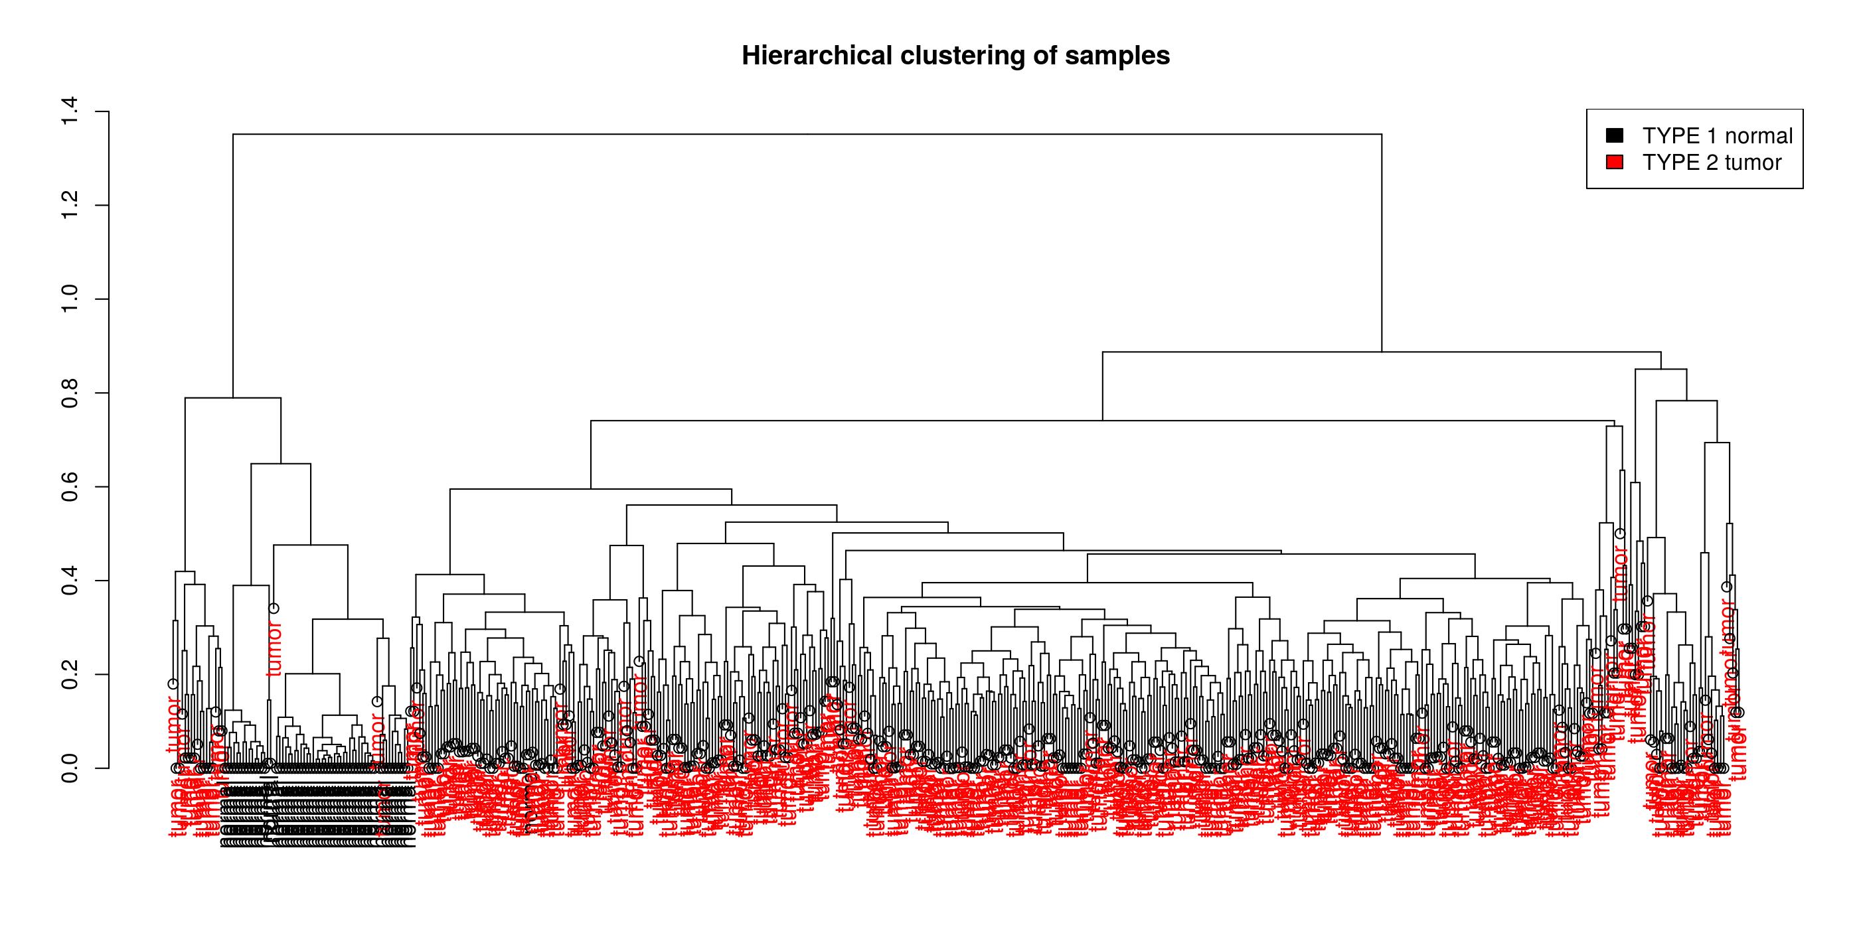
HIERARCHICAL CLUSTERING

Slide 11
naive bayes classifier
448 samples testing
74 samples training
 |  | Observed
 |  | normal | tumor
 | normal | 28 | 33
 | tumor | 1 | 386
Prediction
PRECISION | SPECIFICITY | SENSITIVITY
0.9974 | 0.9655 | 0.9212

Slide 12
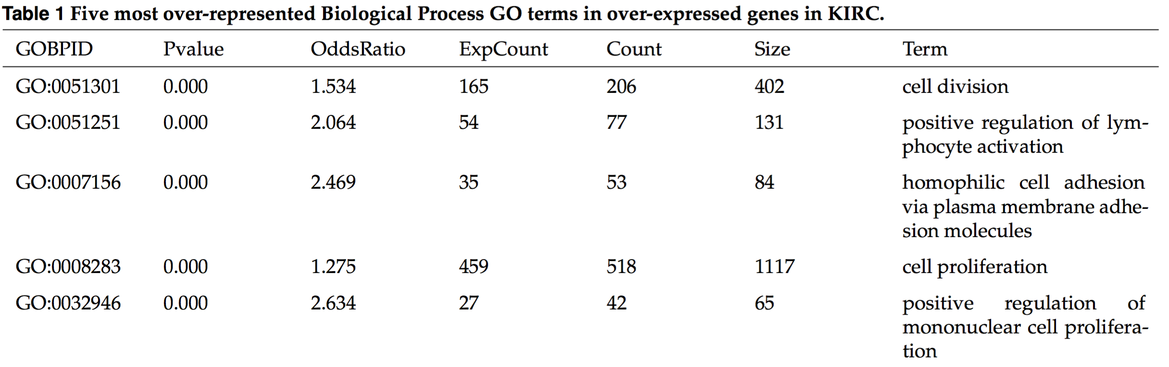
Functional enrichment analysis
Gene Ontology Analysis: Fisher’s Exact Test (P < 0.01).
96 over-represented & 59 under-represented GO terms.

Slide 13
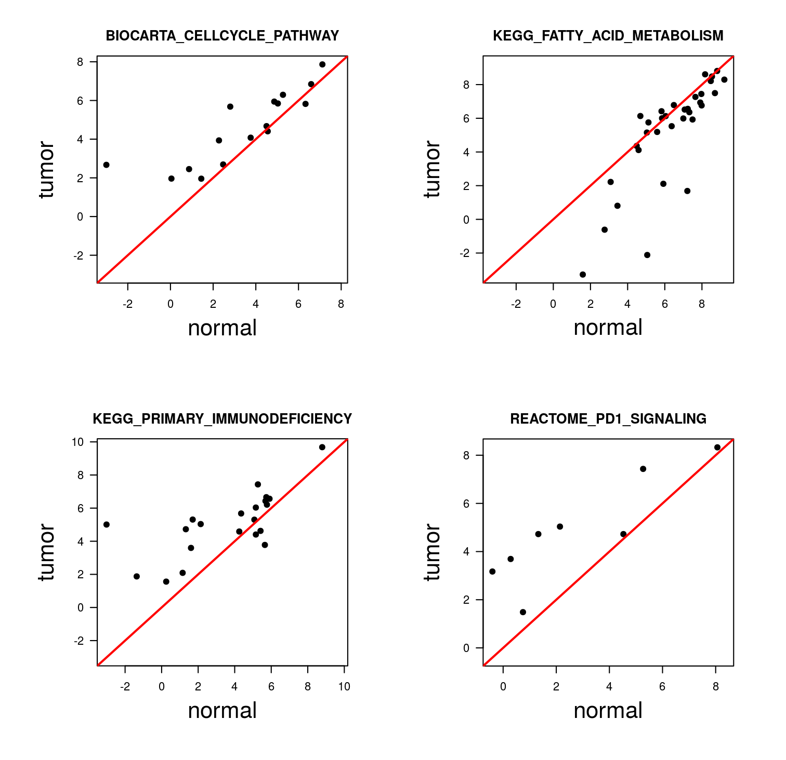
Gene Set Enrichment Analysis

Slide 14
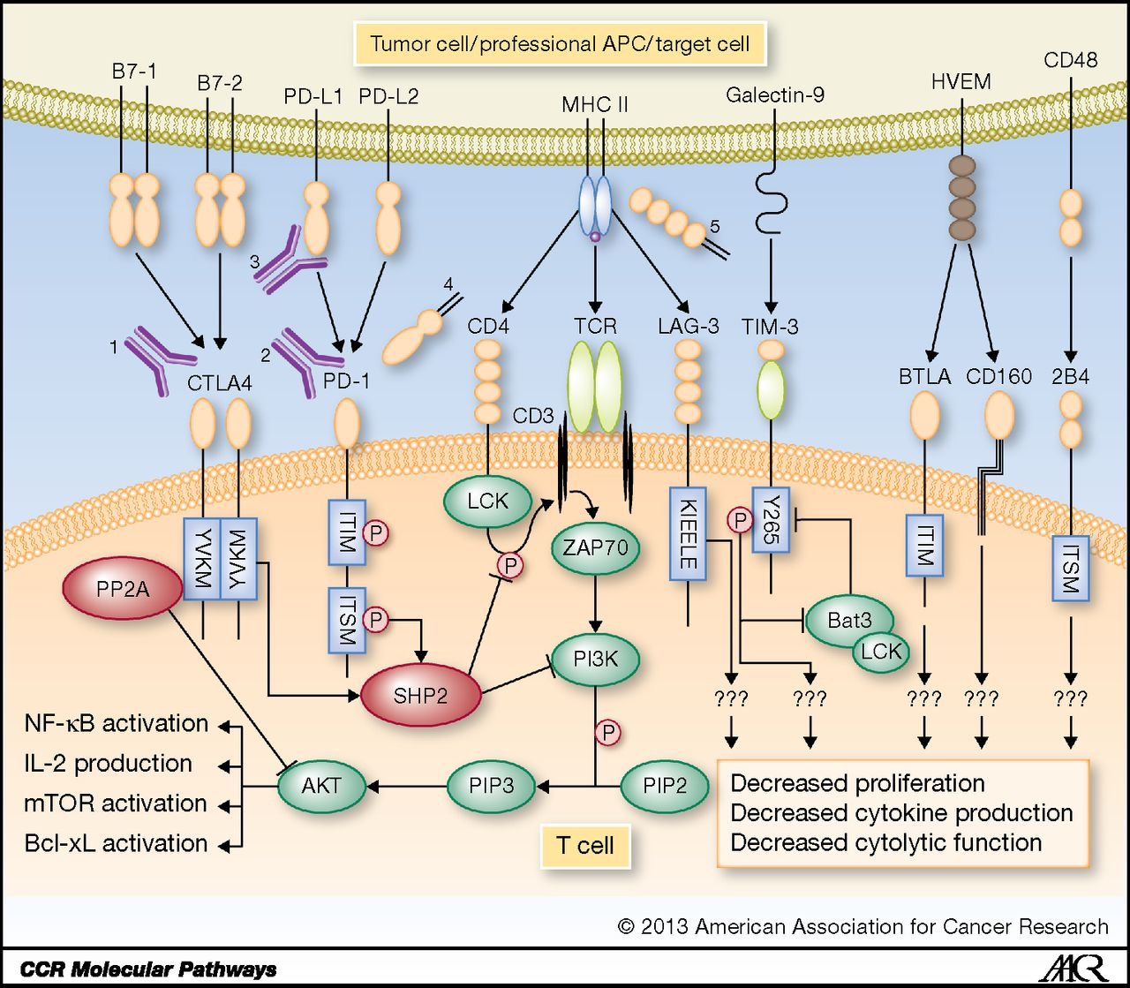
biological characterization
Metabolic shift:
Under-expressed fatty acid degradation and oxidative phosphorylation.
Loss of function:
Less small-molecule/cation transport.
Immune evasion:
PD-1 signalling and T-cell apoptosis.
Ohaegbulam, K. C., Assal, A., Lazar-Molnar, E., Yao, Y., & Zang, X. (2015). Human cancer immunotherapy with antibodies to the PD-1 and PD-L1 pathway. Trends in Molecular Medicine. http://doi.org/10.1016/j.molmed.2014.10.009

Slide 15
conclusion
The most differentially expressed genes have been identified.
KIRC tumour has been biologically characterized.
The Naive Bayes classifier is a good tool to differentiate samples by cell-type using 199 genes.
PD-1 has been identified as a possible target for cancer therapy.

